Slide 1
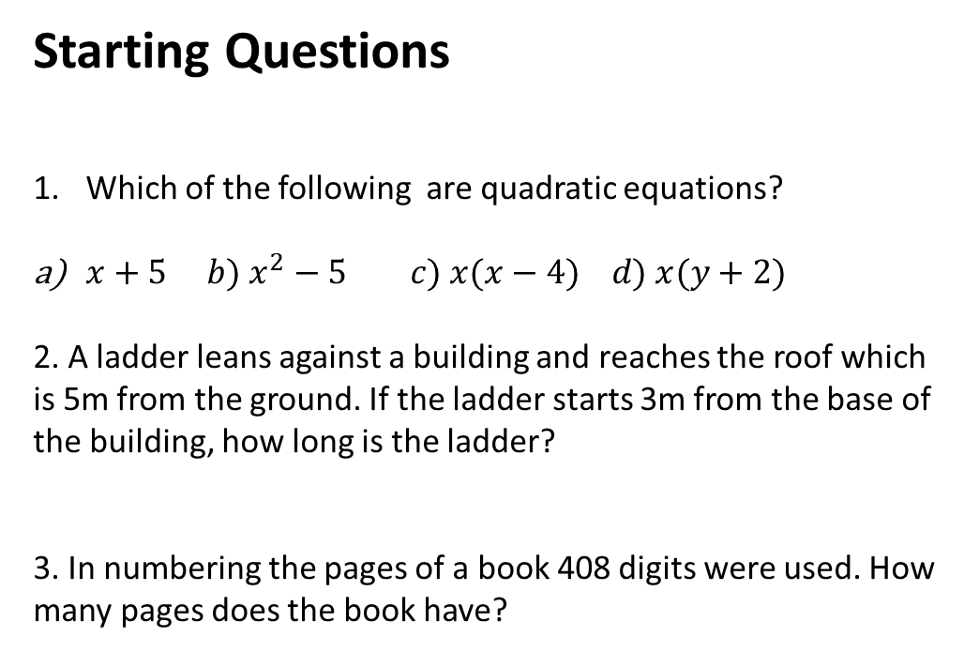
Starting Questions
Which of the following are quadratic equations?
$x+5 b) x^{2}−5 c) x(x−4) d) x(y+2)$
2. A ladder leans against a building and reaches the roof which is 5m from the ground. If the ladder starts 3m from the base of the building, how long is the ladder?
3. In numbering the pages of a book 408 digits were used. How many pages does the book have?

Slide 2


What is a parabola?

Slide 3
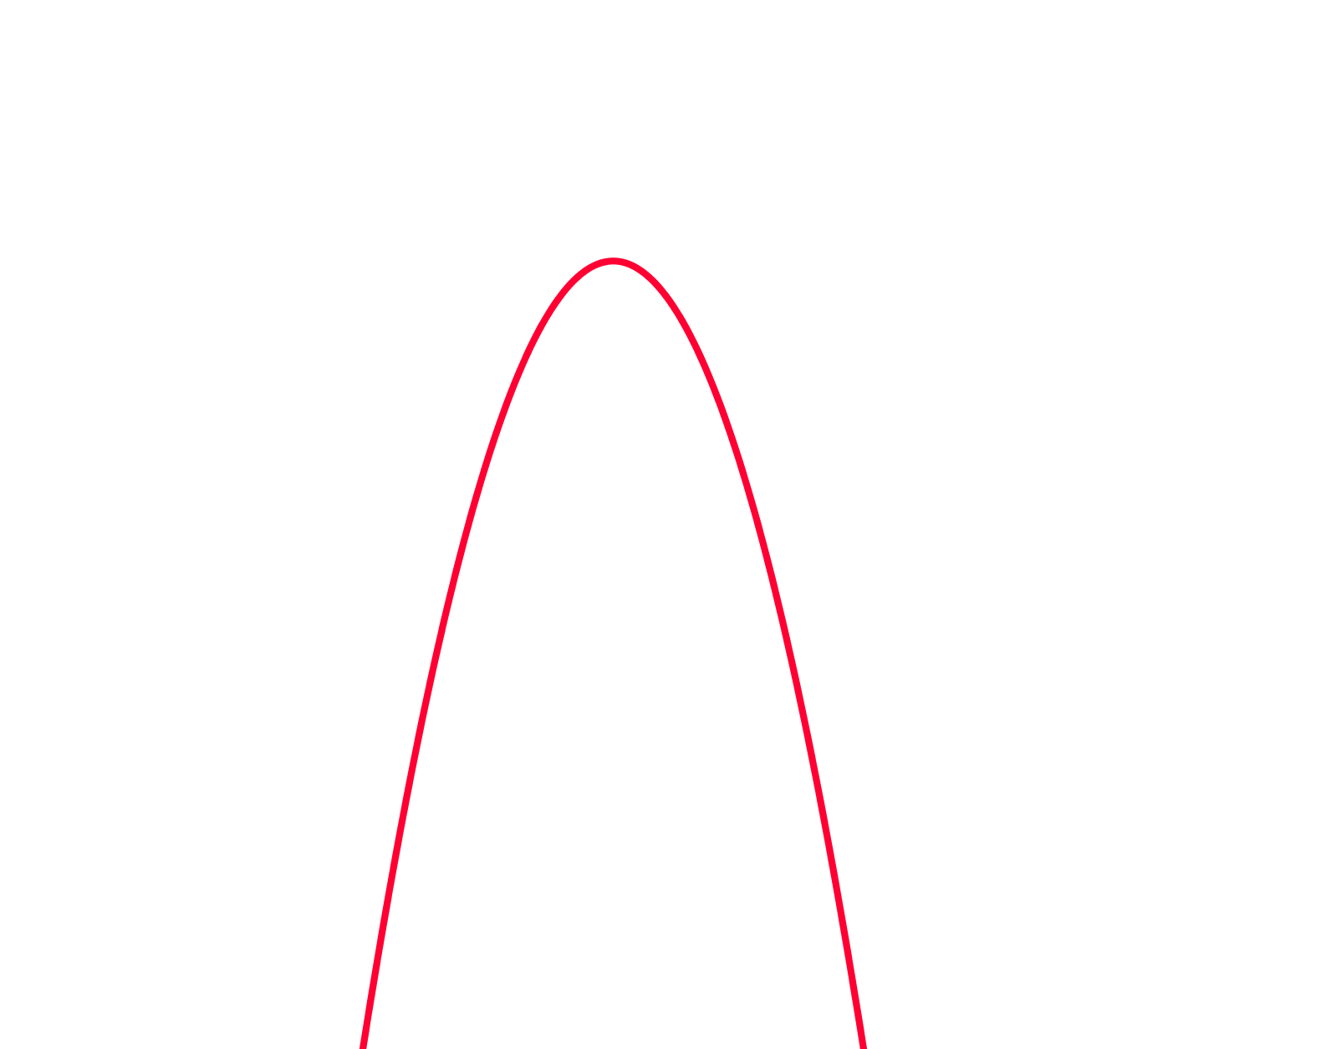
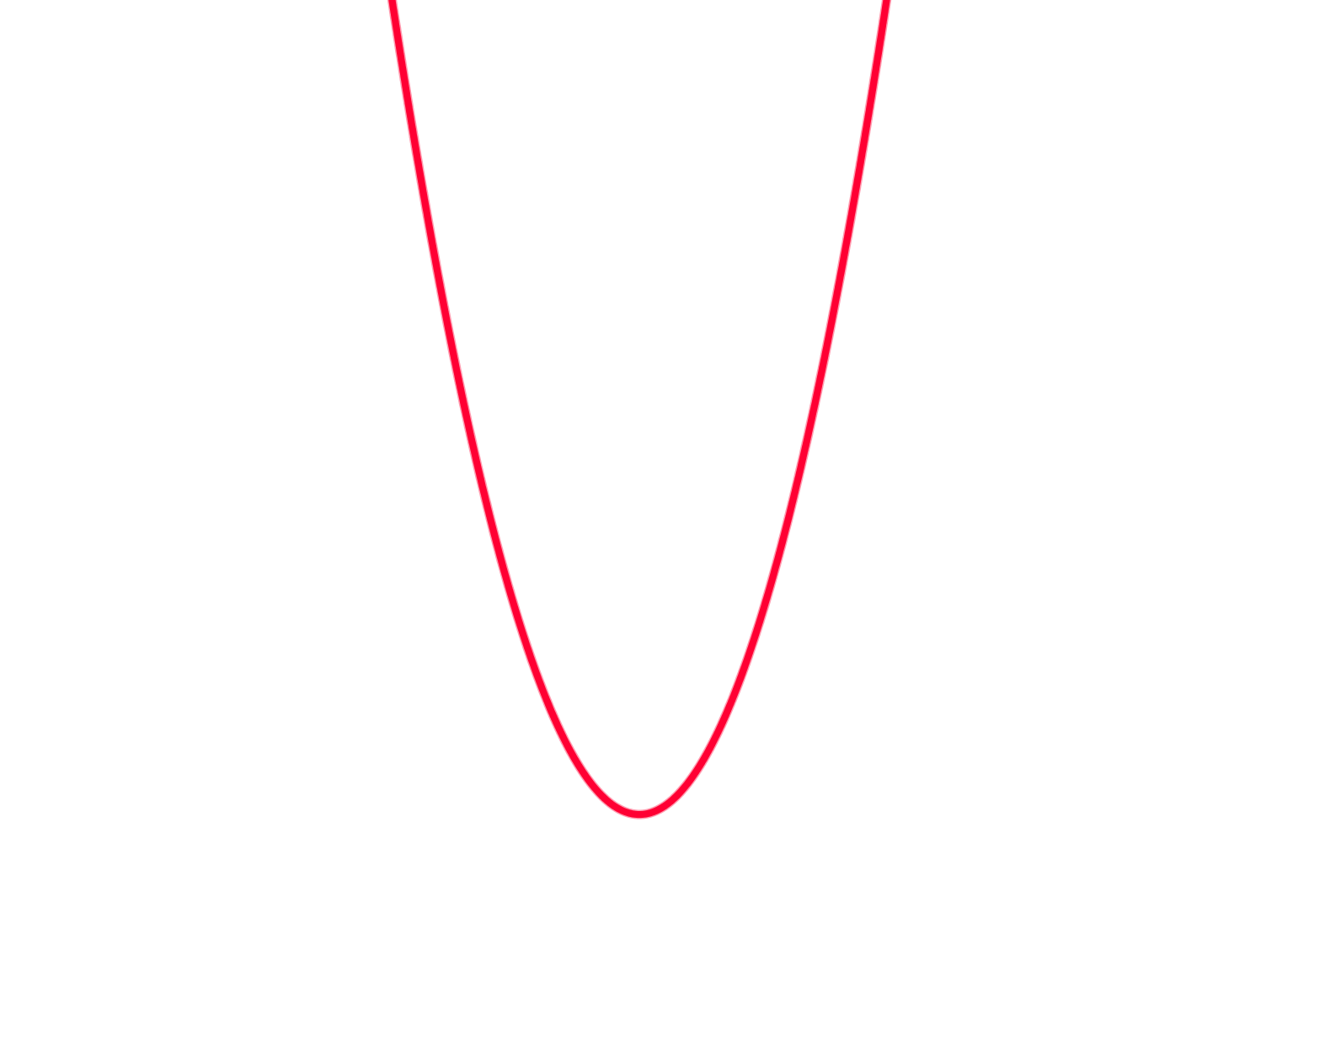


What is a parabola?
This is a positive parabola
This is a negative parabola
Can you think of where you might find a parabola in the real world?

Slide 4

Parabolas are also used in arches and architecture

Slide 5
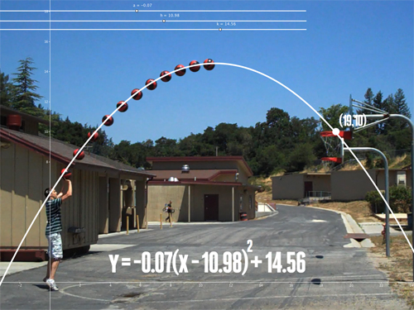

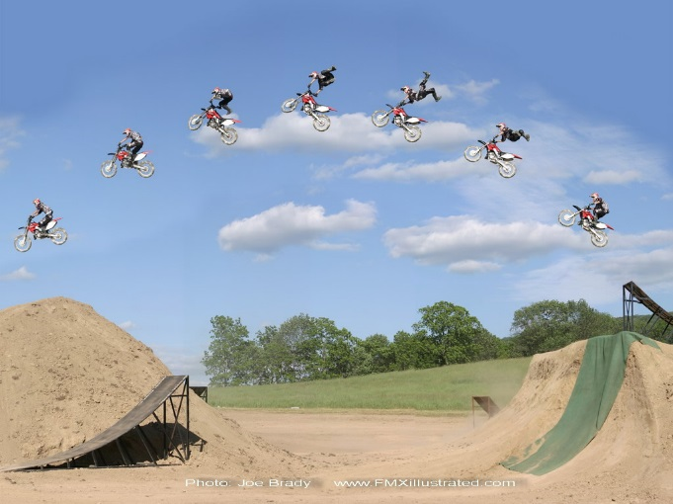
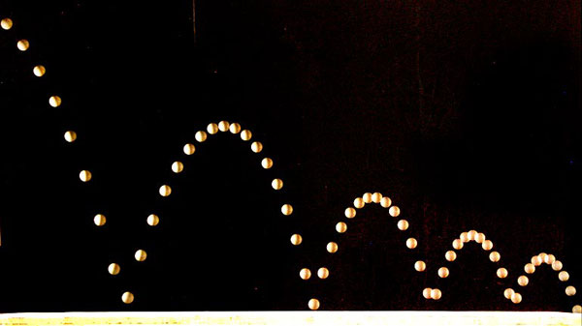
Objects affected by gravity follow a parabolic arc.

Slide 6
24
7
30
Topic: Graphing Quadratic Equation
Date
EQ – What information do we need to graph a parabola?
What is an quadratic equation?
A Quadratic equation has an x² as it’s highest power. When graphed it creates a shape called a parabola.
Examples are y = x²
y = 3x² + 2x + 6
y = -4x² – 5

Slide 7
24
7
30
Topic: Graphing Quadratic Equation
Date
EQ – What information do we need to graph a parabola?
Step 1. To graph a parabola create a table with x values
Step 2. Substitute the x values into the equation
Graph the equation y = x²
x | -3 | -2 | -1 | 0 | 1 | 2 | 3
y
y = x²
y = ( )²
y =
9

Slide 8
24
7
30
Topic: Graphing Quadratic Equation
Date
EQ – What information do we need to graph a parabola?
Step 1. To graph a parabola create a table with x values
Step 2. Substitute the x values into the equation
Graph the equation y = x²
x | -3 | -2 | -1 | 0 | 1 | 2 | 3
y | 9
y = x²
y = ( )²
y =
4

Slide 9
24
7
30
Topic: Graphing Quadratic Equation
Date
EQ – What information do we need to graph a parabola?
Step 1. To graph a parabola create a table with x values
Step 2. Substitute the x values into the equation
Graph the equation y = x²
x | -3 | -2 | -1 | 0 | 1 | 2 | 3
y | 9 | 4
1
0
1
4
9
y = x²
y = ( )²
y =

Slide 10
24
7
30
Topic: Graphing Quadratic Equation
Date
EQ – What information do we need to graph a parabola?
Step 1. To graph a parabola create a table with x values
Step 2. Substitute the x values into the equation
Graph the equation y = x²
x | -3 | -2 | -1 | 0 | 1 | 2 | 3
y | 9 | 4
1
0
1
4
9
This gives us the coordinates that we can graph.
(-3, 9), (-2, 4), (-1, 1), (0, 0), (1, 1), (2, 4), (3, 9)

Slide 11
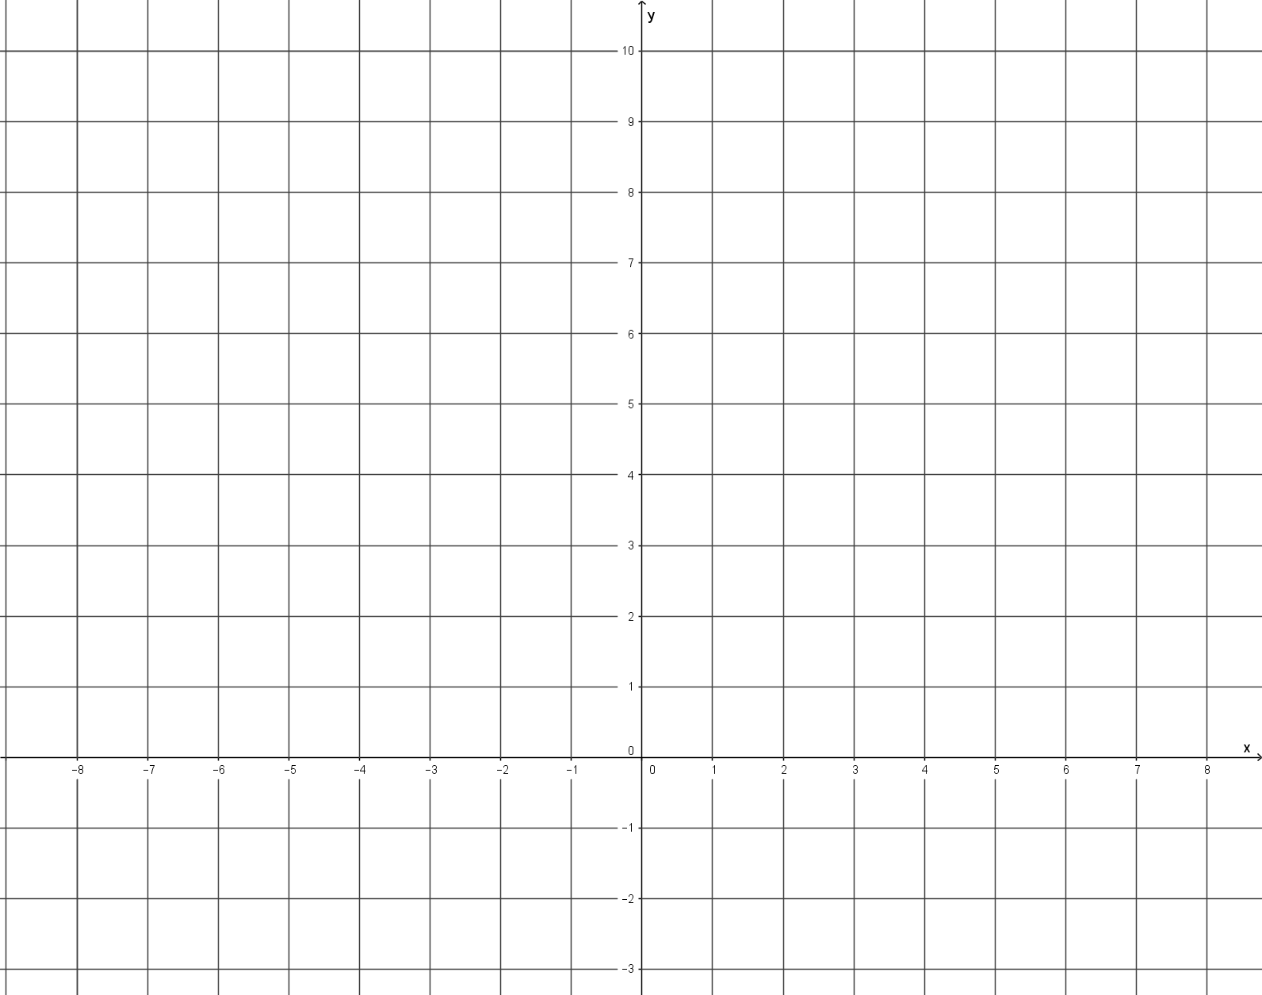
Eg. Graph the equation y = x²
x | -3 | -2 | -1 | 0 | 1 | 2 | 3
y
4
0
4
9
9
1
1
This gives us the coordinates that we can graph.
(-3, 9), (-2, 4), (-1, 1), (0, 0), (1, 1), (2, 4), (3, 9)
y
10
9
8
7
6
5
4
3
2
1
0
1
2
3
-10 -9 -8 -6 -5 -4 -3 -2 -1 0 1 2 3 4 5 6 7 8 9
X

Slide 12
Eg. Graph the equation y = x²
x | -3 | -2 | -1 | 0 | 1 | 2 | 3
y
4
1
0
4
9
9
1
This gives us the coordinates that we can graph.
(-3, 9), (-2, 4), (-1, 1), (0, 0), (1, 1), (2, 4), (3, 9)
y
y
10
9
8
7
6
5
4
3
2
1
0
1
2
3
-10 -9 -8 -6 -5 -4 -3 -2 -1 0 1 2 3 4 5 6 7 8 9
X

Slide 13
Eg. Graph the equation y = x²
x | -3 | -2 | -1 | 0 | 1 | 2 | 3
y
4
1
0
4
9
9
1
This gives us the coordinates that we can graph.
(-3, 9), (-2, 4), (-1, 1), (0, 0), (1, 1), (2, 4), (3, 9)
y
10
9
8
7
6
5
4
3
2
1
0
1
2
3
-10 -9 -8 -6 -5 -4 -3 -2 -1 0 1 2 3 4 5 6 7 8 9
X

Slide 14
Eg. Graph the equation y = x²
x | -3 | -2 | -1 | 0 | 1 | 2 | 3
y
4
1
0
4
9
9
1
This gives us the coordinates that we can graph.
(-3, 9), (-2, 4), (-1, 1), (0, 0), (1, 1), (2, 4), (3, 9)
y
10
9
8
7
6
5
4
3
2
1
0
1
2
3
-10 -9 -8 -6 -5 -4 -3 -2 -1 0 1 2 3 4 5 6 7 8 9
X

Slide 15
Eg. Graph the equation y = x²
x | -3 | -2 | -1 | 0 | 1 | 2 | 3
y
4
1
0
4
9
9
1
This gives us the coordinates that we can graph.
(-3, 9), (-2, 4), (-1, 1), (0, 0), (1, 1), (2, 4), (3, 9)
y
10
9
8
7
6
5
4
3
2
1
0
1
2
3
-10 -9 -8 -6 -5 -4 -3 -2 -1 0 1 2 3 4 5 6 7 8 9
X

Slide 16
Eg. Graph the equation y = x²
x | -3 | -2 | -1 | 0 | 1 | 2 | 3
y
4
1
0
4
9
9
1
This gives us the coordinates that we can graph.
(-3, 9), (-2, 4), (-1, 1), (0, 0), (1, 1), (2, 4), (3, 9)
y
10
9
8
7
6
5
4
3
2
1
0
1
2
3
-10 -9 -8 -6 -5 -4 -3 -2 -1 0 1 2 3 4 5 6 7 8 9
X

Slide 17
Eg. Graph the equation y = x²
x | -3 | -2 | -1 | 0 | 1 | 2 | 3
y
4
1
0
4
9
9
1
This gives us the coordinates that we can graph.
(-3, 9), (-2, 4), (-1, 1), (0, 0), (1, 1), (2, 4), (3, 9)
y
10
9
8
7
6
5
4
3
2
1
0
1
2
3
-10 -9 -8 -6 -5 -4 -3 -2 -1 0 1 2 3 4 5 6 7 8 9
X

Slide 18
Eg. Graph the equation y = x²
x | -3 | -2 | -1 | 0 | 1 | 2 | 3
y
4
1
0
4
9
9
1
This gives us the coordinates that we can graph.
(-3, 9), (-2, 4), (-1, 1), (0, 0), (1, 1), (2, 4), (3, 9)
y
10
9
8
7
6
5
4
3
2
1
0
1
2
3
-10 -9 -8 -6 -5 -4 -3 -2 -1 0 1 2 3 4 5 6 7 8 9
X

Slide 19
Eg. Graph the equation y = x²
x | -3 | -2 | -1 | 0 | 1 | 2 | 3
y
4
1
0
4
9
9
1
This gives us the coordinates that we can graph.
(-3, 9), (-2, 4), (-1, 1), (0, 0), (1, 1), (2, 4), (3, 9)
y
10
9
8
7
6
5
4
3
2
1
0
1
2
3
Now join the dots
-10 -9 -8 -6 -5 -4 -3 -2 -1 0 1 2 3 4 5 6 7 8 9
X

Slide 20
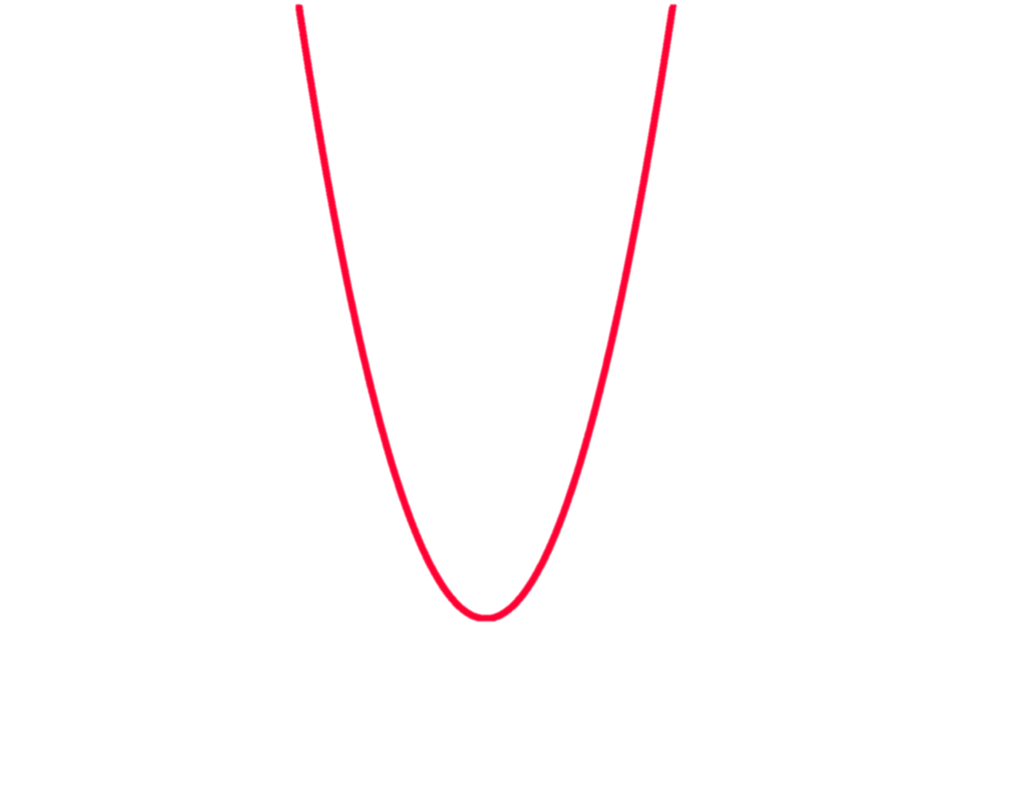
Eg. Graph the equation y = x²
x | -3 | -2 | -1 | 0 | 1 | 2 | 3
y
4
1
0
4
9
9
1
This gives us the coordinates that we can graph.
(-3, 9), (-2, 4), (-1, 1), (0, 0), (1, 1), (2, 4), (3, 9)
y
10
9
8
7
6
5
4
3
2
1
0
1
2
3
-10 -9 -8 -6 -5 -4 -3 -2 -1 0 1 2 3 4 5 6 7 8 9
X

Slide 21
Eg. Graph the equation y = x²
x | -3 | -2 | -1 | 0 | 1 | 2 | 3
y
4
1
0
4
9
9
1
This gives us the coordinates that we can graph.
(-3, 9), (-2, 4), (-1, 1), (0, 0), (1, 1), (2, 4), (3, 9)
y
10
9
8
7
6
5
4
3
2
1
0
1
2
3
Where the graph turns is called the turning point or vertex
-10 -9 -8 -6 -5 -4 -3 -2 -1 0 1 2 3 4 5 6 7 8 9
X

Slide 22
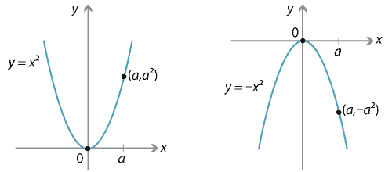
y = - x²
Gives an upside down parabola

Slide 23
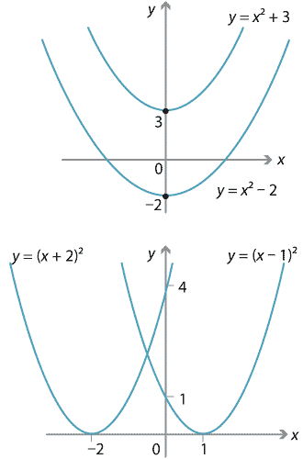
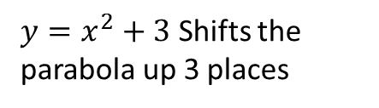
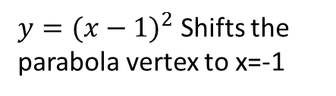
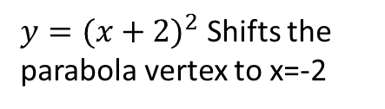
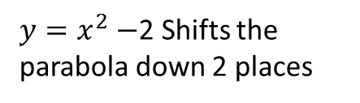
$y=x^{2}+3$ Shifts the parabola up 3 places
$y=x^{2}−$2 Shifts the parabola down 2 places
$y={(x+2)}^{2}$ Shifts the parabola vertex to x=-2
$y={(x−1)}^{2}$ Shifts the parabola vertex to x=-1

Slide 24
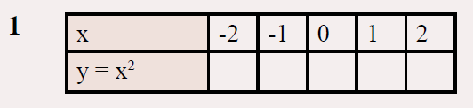
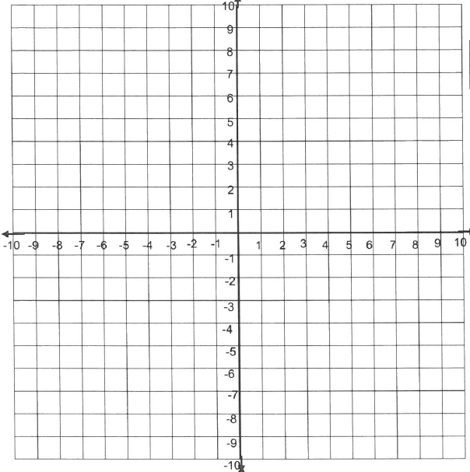
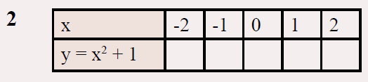
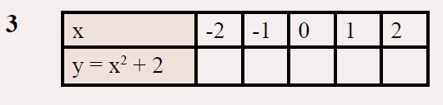
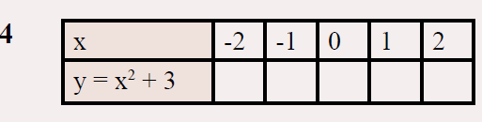
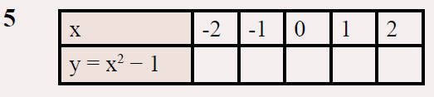
I will be collecting your work to mark!! Page 55 in the textbook

Slide 25
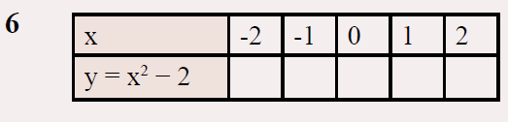
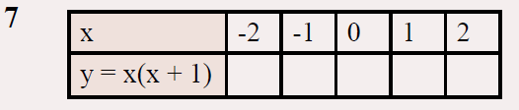
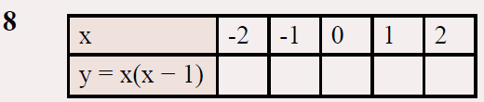
I will be collecting your work to mark!!

